Slide 1
Phenomenawork v2.01
Hypnosis Beyond Trance
- By Weaver
@EH BookClub
April 2025
Notes:
Start in the middle

Slide 2
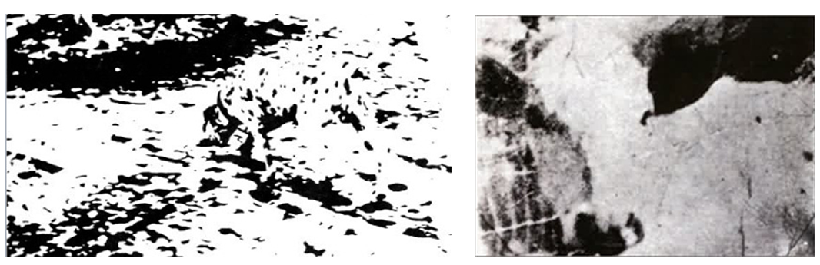

What is this?
Notes:
Give them the form 1. We wait 5 minutes, play pleasant music

Slide 3
Phenomenaworks
Hypnosis Beyond Trance: Phenomenal Magic
- By Wyrdweaver
@EH BookClub
April 2025
o

Slide 4
phenomenal
adjective
phe·​nom·​e·​nal fi-ˈnä-mə-nᵊl
a: known through the senses rather than through thought or intuition
b: concerned with phenomena rather than with hypotheses
c: EXTRAORDINARY, REMARKABLE
Notes:
Phenomena vs Noumena – from Kant

Slide 5


“Who is the great magician who makes the grass green?”
Ariane by Sofia Borati
This Weight on My Shoulders by @photonisdead
Notes:
Phenomena vs Noumena We never see the world as our retina sees it. In fact, it would be a pretty horrible sight: a highly distorted set of light and dark pixels, blown up toward the center of the retina, masked by blood vessels, with a massive hole at the location of the “blind spot” where cables leave for the brain; the image would constantly blur and change as our gaze moved around. What we see, instead, is a three-dimensional scene, corrected for retinal defects, mended at the blind spot, stabilized for our eye and head movements, and massively reinterpreted based on our previous experience of similar visual scenes. All these operations unfold unconsciously—although many of them are so complicated that they resist computer modeling. For instance, our visual system detects the presence of shadows in the image and removes them. At a glance, our brain unconsciously infers the sources of lights and deduces the shape, opacity, reflectance, and luminance of the objects.

Slide 7
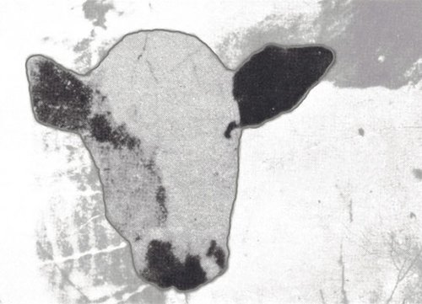

Slide 8
Meaning is Made
Sine wave speech: A Cow and A Dalmation
Notes:
Meaning is made, and cannot be unmade

Slide 9
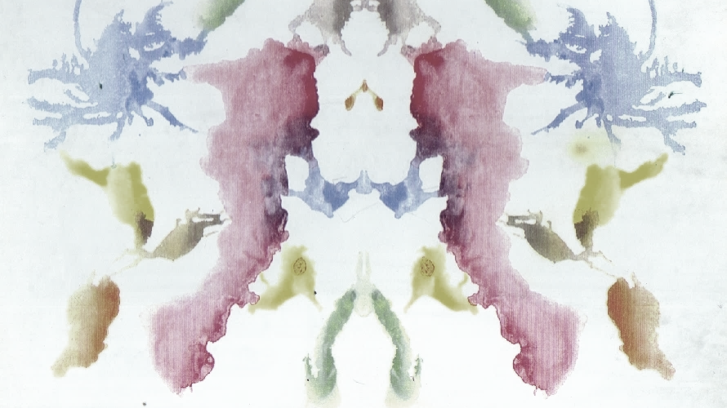
ACT I : Expectations
Shape Experience

Slide 10
Disclaimers: Setting Expectations
You are going to have to humor me
Subject skills centered
Participatory Nature
Eclectic, Synthetic Approach
Building a composite map
Notes:
I am just me, staying secular and scientific to the best of my ability, probably going to be wrong about more than one thing by the end, Imagine I am a better Hypnotist (Adam Eason)
How demo is going to work, how to opt out, office hours

Slide 11
Skills Training Approach
Hypnotic Phenomena are skills that can be cultivated
Learning how to learn these skills are skills in themselves
The Mindset you approach this with are meta-skills
You might not *want* to develop them!
But it’s important to know that you can, if you do!
Notes:
Talk about CSTP, Erickson, mesmerists and somnambulist

Slide 12
Mindset Matters
Motivated
Confident
Optimistic
Curious and Anticipatory*
Expecting to enjoy the process
Credits: Adam Eason
*WW

Slide 13

Direction over Destination
An opportunity to experience shifts in experience however they present to us
Enjoying the Process of Engaging and Responding rather than the looking for the “one right answer”
Response happens by feeling good, not by feeling bad

Slide 14

The Right Effort of Beginning Again
Letting go of thoughts that make you disengage
Focusing on what you want to see more of

Slide 15

Savoring The “Just Noticeable Difference”
Small miracles can snowball

Slide 16
ACT II : Shape
Experience - Engineering Enchantments

Slide 17
Kinds of Phenomena
Motor - Movement, flaccidity, rigidity, catalepsy/stasis
Cognitive - Fixation, Absorption, Dissociation, Amnesia, Regression
Affective - Mood, emotion, feelings
Perceptual - Positive and Negative VAKOG Hallucinations, Heightened sensitivity vs insensitivity analgesia/anesthesia
James Tripp: Ideodynamic Model
Also, Rossi, others – see HWT notes

Slide 18
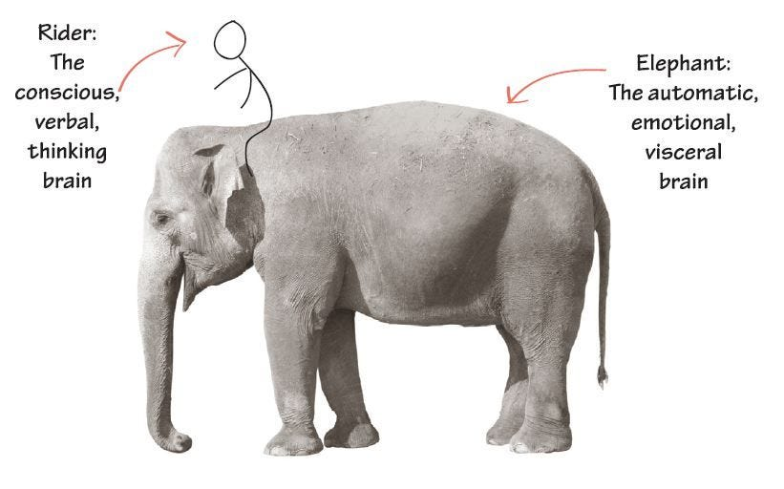
The Conscious/Unconscious Model
Erickson would say:
You have a Conscious Mind and you have an Unconscious Mind
Elman would say:
Critical Faculty
Kahneman would say:
Two Systems of thinking, System 1 vs System 2
Haidt would say:
https://en.wikipedia.org/wiki/Dual_process_theory
Notes:
Triadic – plato/Aristotle/phaedreus Hindu senses-reason-soul

Slide 19
Phenomena Hands On
Influences here: Norman Vaughton, James Tripp, Stephen Gilligan
Notes:
This was an adapted Magnetic Hands Demo, similar to: https://www.youtube.com/watch?v=xMGqoTZAAl0&t=159s
Give them form 2.

Slide 20
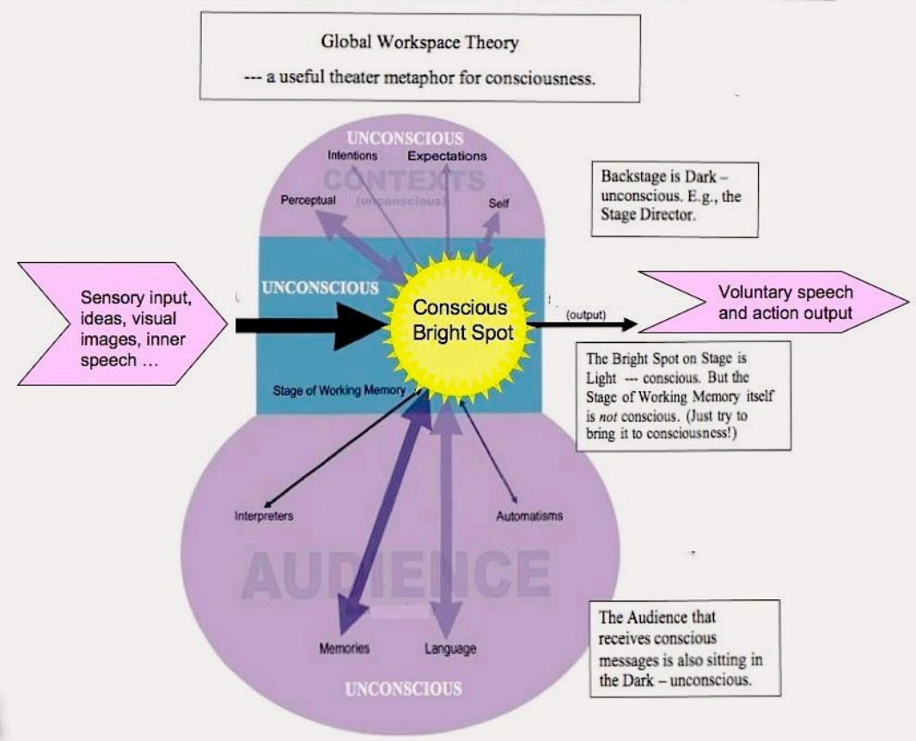
(Baars)

Slide 21
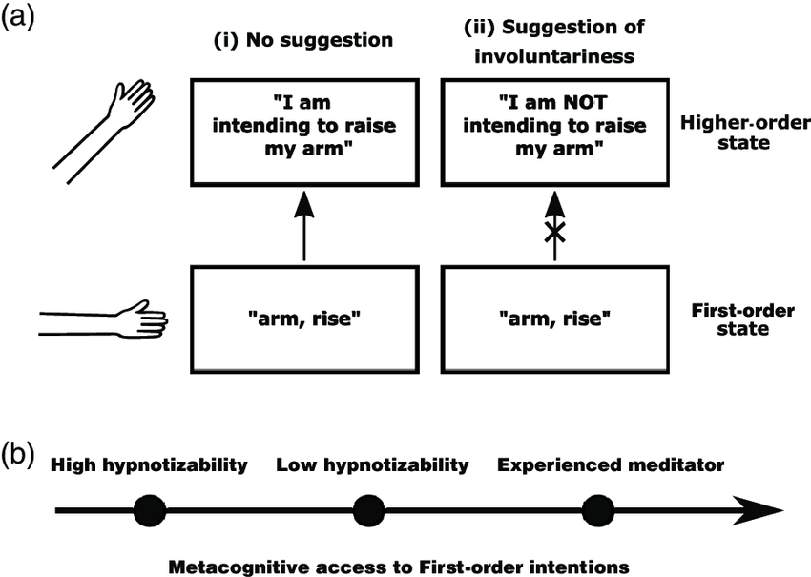
The Cold Control Theory
Peter Lush, Zoltan Dienes
Notes:
Turning a doing into a happening

Slide 22
Automatic Imagination Model
"The change involves avoiding accurate HOTs* as well as entertaining inaccurate HOTs.“
Imagine, Ignore, Obstruct the *“Reminders of Reality”
Base Level of Imagination: The initial act of imagining something (like a hand being stuck to a table) creates a reality that the individual knows is imagined. They can stop imagining at any moment.
Second Level of Imagination: While maintaining the initial imagination (the hand is stuck), the individual also imagines they are unaware of the act of imagining. This results in the effect being experienced as if it occurred automatically and beyond the individual's control.
Use emotion
End result: an uncritical focus on current and anticipated experience
Anthony Jacquin and Kev Sheldrake
https://rtfc.org.uk/FreeYourMindPart1.html

Slide 23
Imaginative Suggestibility
Hypnotic trance inductions have statistically significant but very small increases in scores on hypnosis suggestibility scales when compared to suggestions given without trance under the imagination condition
Suggestibility scales are mostly Phenomena scales
(Irving Kirsch)

Slide 24
Tasting Phenomena
Imagine that you are holding a lemon (and really do this read this slowly and immerse yourself as fully as you can in the imaginative experience). You can see it in your hand. You can see its yellow colour and feel its texture. Now imagine cutting into the lemon with a knife so the juice oozes out and may even squirt a little at you. Imagine bringing the lemon up to your mouth and biting deeply into its flesh so you feel the juice filling your mouth and taste that sharp tang' of fresh lemon. As you exercise your imagination in this way, you will probably find yourself beginning to salivate somewhat. Whilst this may not work for everyone just through reading it through (fixed, written words are no substitute for a live, dynamic hypnotic facilitation full immersion in this as an imagined experience invariably creates changes to salivation and mouth sensation for all normally functioning human beings.
Notes:
Imagine that you are holding a lemon (and really do this read this slowly and immerse yourself as fully as you can in the imaginative experience). You can see it in your hand. You can see its yellow colour and feel its texture. Now imagine cutting into the lemon with a knife so the juice oozes out and may even squirt a little at you. Imagine bringing the lemon up to your mouth and biting deeply into its flesh so you feel the juice filling your mouth and taste that sharp tang' of fresh lemon. As you exercise your imagination in this way, you will probably find yourself beginning to salivate somewhat. Whilst this may not work for everyone just through reading it through (fixed, written words are no substitute for a live, dynamic hypnotic facilitation full immersion in this as an imagined experience invariably creates changes to salivation and mouth sensation for all normally functioning human beings.

Slide 25
Phenomenological Control
Outside the Context
No Hypothesis
Aware of the hypothesis
Mistaken about the hypothesis
Level 1: Beliefs
Compliance
Reactance
Level 2: Motivation
Conscious Compliance: Playing Along
Conscious Imagination:
Genuine Experience
Phenomenological Control:
Genuine Experience
Level 3: Response
(Un/conscious Strategy)
Fuzzy Boundaries

Slide 26
Hypnotic Loop
Experience
Belief
Imagination
(Mind Flow)
Physiology
(James Tripp)

Slide 27
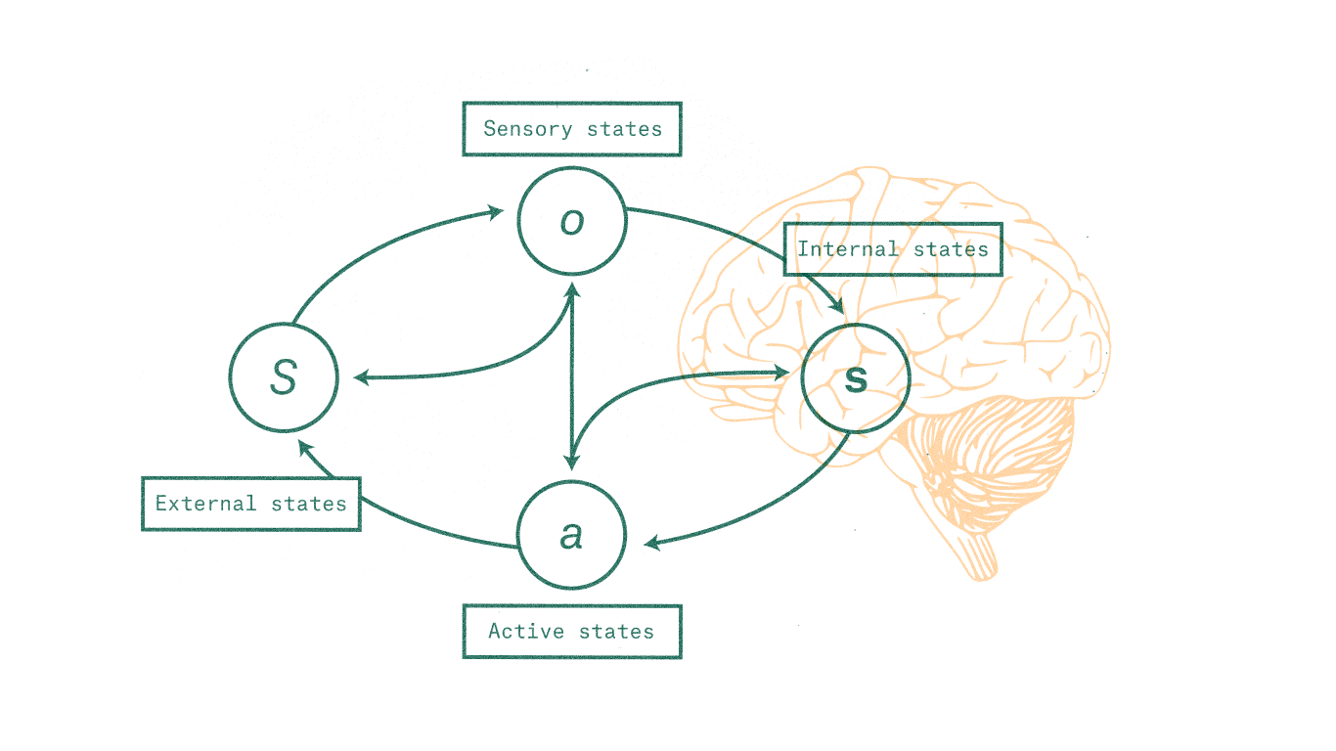
Predictive Processing
Eyes
Maps
Territory
Navigation
Karl Friston, Maxwell Ramstead, Andy Clark

Slide 28
A convergence of cybernetics
Experience
Belief
Imagination
(Mind Flow)
Physiology

Slide 29
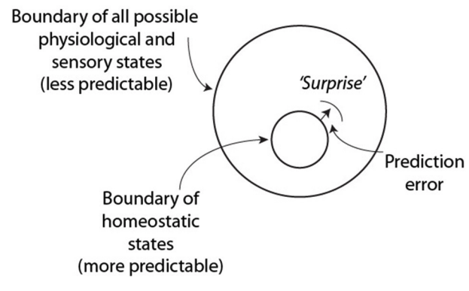
Expectation and Subversion
Subversions of prior expectations alter those expectations. New maps of what seems possible are built because more seems plausible.
Karl Friston

Slide 30
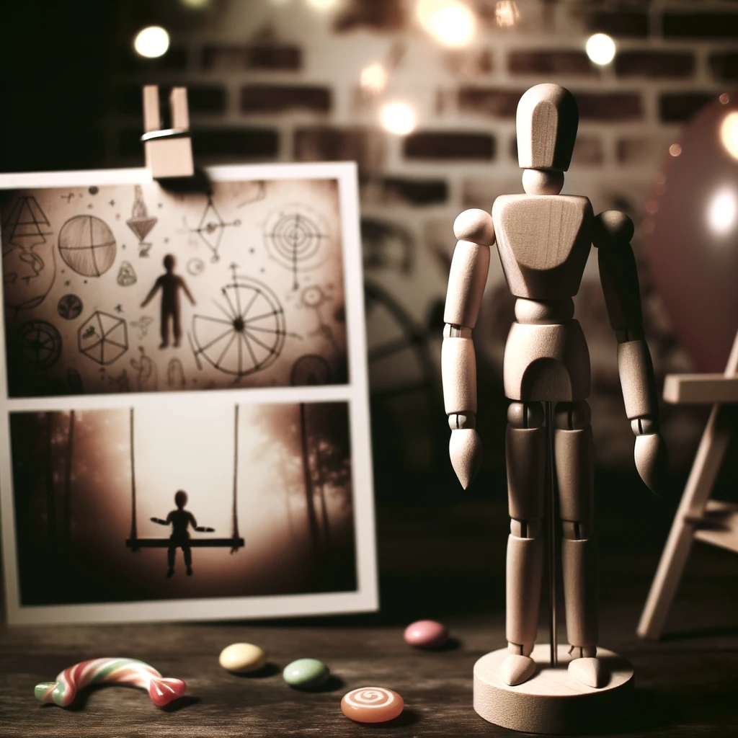
Haunting a Doll – Woodweaver Redux
Notes:
Emotions Phosphenes
Chills

Slide 31
Pacing and Leading - Abstract Conditioning
Pacing: matching (pacing) the current experience
Observation of Reality: So now as we are talking
Sensory Experience: …you can notice your weight on the surface below you
Internal States and Processes: as other thoughts may come and go,
Leading:
You can begin to let yourself relax into an attentive focus as you listen and engage fully

Slide 32
Intervening at the level of Physiology - Changing the Territory
“Convincers”
Visual Hallucination
Kirsch
Ganzfeld and sensory deprivation- https://fetlife.com/users/5867027/posts/8172152 - https://www.researchgate.net/publication/281058302_Effects_of_Dry_Flotation_Restricted_Environmental_Stimulation_on_Hypnotizability_and_Pain_Control
Rubber Hand Illusion – Replication of the study I mentioned that came out 10 days ago that I didn’t know when I was presenting: https://online.ucpress.edu/collabra/article/10/1/116190/200587/Order-Effects-on-the-Rubber-Hand-Illusion
Conditioning response: https://www.ncbi.nlm.nih.gov/pmc/articles/PMC6127761/

Slide 33
Ambiguity
Verbal
Non verbal

Slide 34
Leaning In
Being sensitized to subtle noticeable differences - vaguely perceptible cues
Pareidolia
Cultivating apopheniac sensibilities

Slide 35
Utilization
Clean Language
Changing the Territory
Rolling with Resistance

Slide 36
Grammar of Phenomenal Magic
Analog vs Digital
Constrained choices or “Double Binds”
Plausibility
Pantomiming
Coaching Engagement
Calibrating Loops
Story Logic
Notes:
Successive approximation - loops

Slide 37
If at 70-75 min, do bridge/fingerstick/amnesia/visual hallucination

Slide 38
ACT III : Experience
Meaning Making

Slide 39
Framing Phenomena
Enchantment and Disenchantment (Max Weber)
Metamodernism
Notes:
What is Magic?

Slide 40
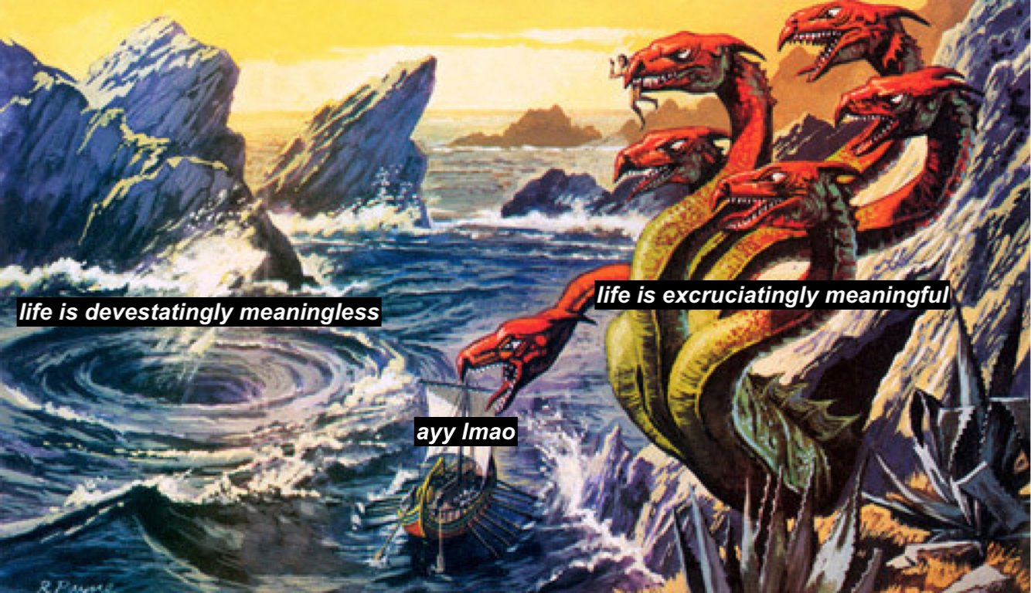
@visakanv

Slide 41
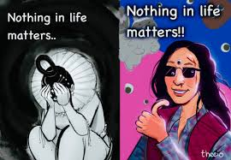
Everything Everywhere All At Once – A Metamodern Movie

Slide 42
Dynamics of Miracles
Confusion
Wonder
Terror
Humour

Slide 43
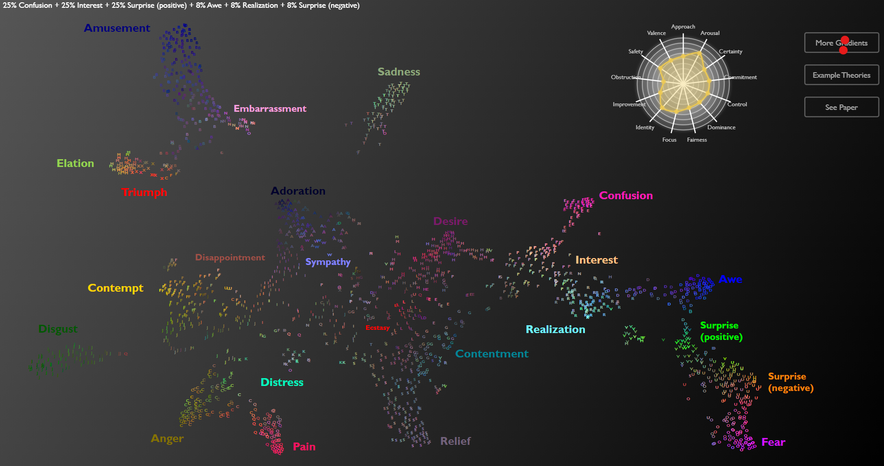
Mapping 24 Emotions Conveyed by Brief Human Vocalization. Cowen et al. 2019
https://s3-us-west-1.amazonaws.com/vocs/map.html#

Slide 44
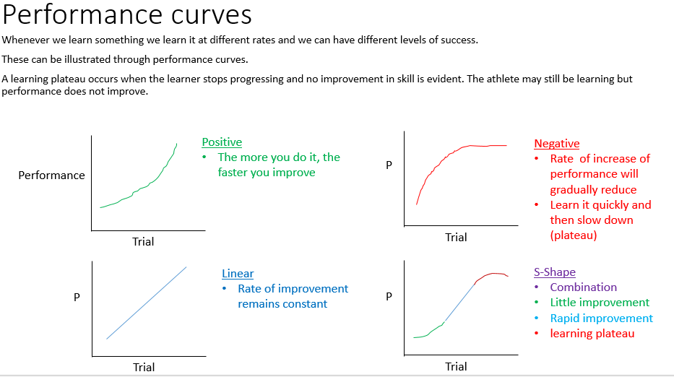
Skills Progression
Notes:
Progress often has S shape and sequential daisy chained S shapes progress curves. You figure out the knack of things, the certain mental tricks that make a particular phenomena work (better) for you and have rapid improvement. Play at the edge of your ability, using your strengths as booster packs and find the path of least resistance.

Slide 45
Inter and Intra Scene Periodization
When do you stop?
New Status quo
Status quo
TITRATING THE STIMULUS
Notes:
Beliefs and framing shape expectations and mindsets, they in turn, shape experience. It tends to be useful to operate at two levels, a base level understanding of the ground truth that is unshakable and then a play level on top of it that's built of metaphorical "story logics". A lot of 'safeties' in and out of the community tend to operate at the level of story logics. This can work but the safeties can turn maladaptive if you start confusing the story logic with the ground truth. Fictions should be for play, not to build your understanding of yourself as a person and some of the catastrophic failure modes related to identity and memory play tend to operate in this failure mode.

Slide 46
Making it meaningful: Beyond Tricks
And a note of caution.
Notes:
Beliefs and framing shape expectations and mindsets, they in turn, shape experience. It tends to be useful to operate at two levels, a base level understanding of the ground truth that is unshakable and then a play level on top of it that's built of metaphorical "story logics". A lot of 'safeties' in and out of the community tend to operate at the level of story logics. This can work but the safeties can turn maladaptive if you start confusing the story logic with the ground truth. Fictions should be for play, not to build your understanding of yourself as a person and some of the catastrophic failure modes related to identity and memory play tend to operate in this failure mode.
Apophenia is a symptom of schizophrenia, you can make too much meaning, you can stretch too far.
If you titrate and pull back by going 2 steps forward, 1 step back, you get more opportunities to spot good times to stop. This helps even inter session, you might want to periodize intensity, building it up over time and then pull back and rest, recoup before getting back to intensification

Slide 47
The End : The Beginning (Again)
Make it Real
- WW
Notes:
It’s a loop. It’s a beginning, your beginning, go make it real.
Being controversial - I am staying secular, but push comes to shove, I will go with science and the science of magic – Religion as Make Believe by Neil Van Leeuwen
Form 3

Slide 48
Francis Bacon Anecdote

Slide 49
The Problem of Parts
A useful model with catastrophic failure modes especially in hypnokink
Subjects, hypnotees begin to personifying the unconscious
‘You cannot assume that whatever this persona says is automatically true, or somehow the most "core" part of them, or immutable, etc. It is something that is being constructed, it is capable of flaws, it should generally not be the only way you address consent (especially if your partner expresses discomfort -- talk to them when they're awake), etc etc.’ - /u/h-sleepingirl

Slide 50
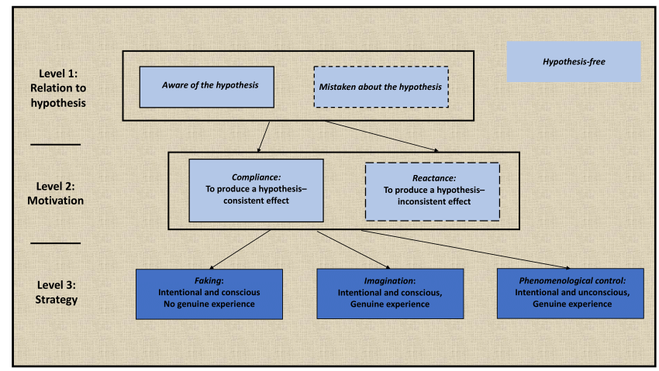
Phenomenological Control
Fuzzy Boundaries

Slide 51
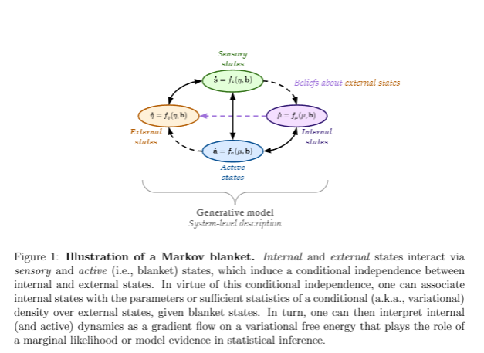

Slide 52
Suggestion | SWASH Subjective score Mean | SWASH SD | PCS Subjective score Mean | PCS SD | SWASH Objective Pass Percentage | PCS Objective Pass Percentage
1. Hand lowering | 3.2 | 1.5 | 3.6 | 1.2 | 57.5 | 63.9
2. Moving hands together | 2.6 | 1.5 | 3.1 | 1.3 | 67.5 | 75.4
3. Mosquito hallucination | 1.0 | 1.3 | 1.7 | 1.5 | 28.8 | 44.7
4. Taste hallucination | 1.1 | 1.2 | 1.8 | 1.3 | 50.0 | 66.0
5. Arm rigidity | 2.5 | 1.5 | 3.2 | 1.4 | 46.3 | 55.7
6. Arm immobilisation | 2.0 | 1.4 | 2.7 | 1.4 | 31.3 | 45.1
7. Music hallucination | 0.1 | 0.5 | 0.3 | 0.8 | 3.7 | 8.2
8. Negative visual hallucination | 0.2 | 0.9 | 0.4 | 1.2 | 2.1 | 3.7
9. Amnesia | 1.6 | 1.4 | 1.6 | 1.4 | 15.4 | 14.8
10. Post-session suggestion | 1.0 | 1.4 | 0.9 | 1.5 | 41.7 | 29.1

